Slide 1
45 Day Check-in and Preparing for Budget Development
GO Team Business Meeting #3

Slide 2
Agenda
Continuous Improvement Plan
45 Day Check-in
Review of Strategic Plan and priorities progress
Preparing for the Budget Development
Rank Strategic Priorities

Slide 3
Timeline for GO Teams
You are HERE
1
2
3
4
5
1
2
3
4
5
Fall 2021
GO Team Developed 2021-2025 Strategic Plan
Summer 2023
School Leadership completed Needs Assessment and defined overarching needs for SY23-24
August 2023
School Leadership completed 2023-2024 Continuous Improvement Plan
Sept. – Dec. 2023
Utilizing current data, the GO Team will review & possibly update the school strategic priorities and plan
Before Winter Break
GO Team will take action (vote) on the school’s strategic plan and vote on the ranked strategic plan priorities for SY24-25 budget discussions.

Slide 4
Continuous Improvement Plan

Slide 5
Quarterly CIP Check-in
Questions to Consider
Based on our year long CIP plan, what are the actions that the school has already completed?​
What data supports the completion of an action step and success criteria (both implementation and student achievement)?

Slide 6
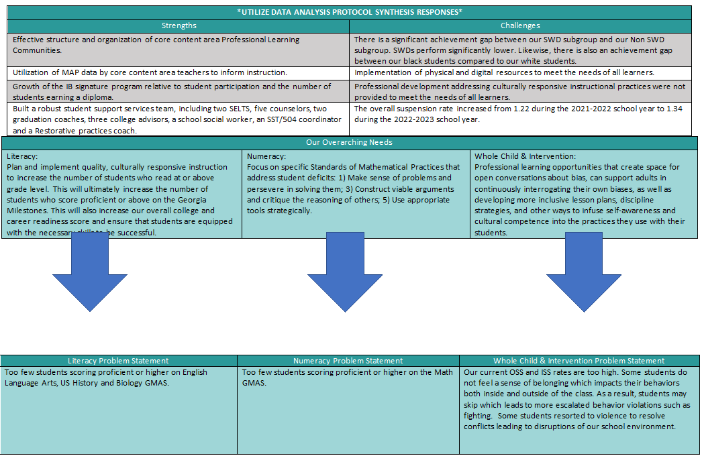

Slide 7
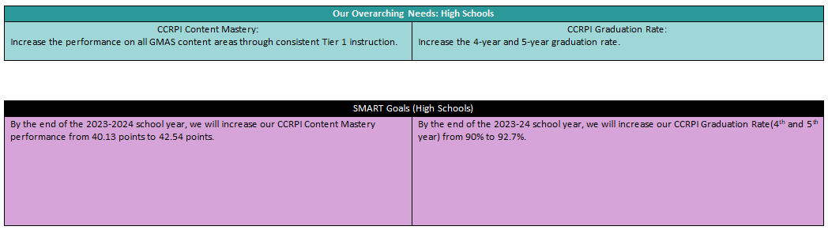
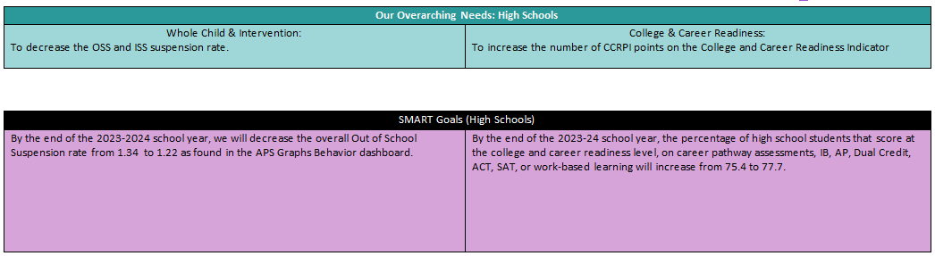
Needs Assessment
Notes:
Notes for School CIP Teams: After completing your Comprehensive Needs Assessment ( data protocol), you will come here and identify some strengths and opportunities/challenges you have observed from the data. The priority areas are Literacy, Numeracy, and Whole Child & Student Support. Identify an overarching need for each area. Formulate a problem statement for each area. Make sure the problem statement meets the criteria. Refer to your CIP resources.

Slide 8
Strategic Plan Progress

Slide 9
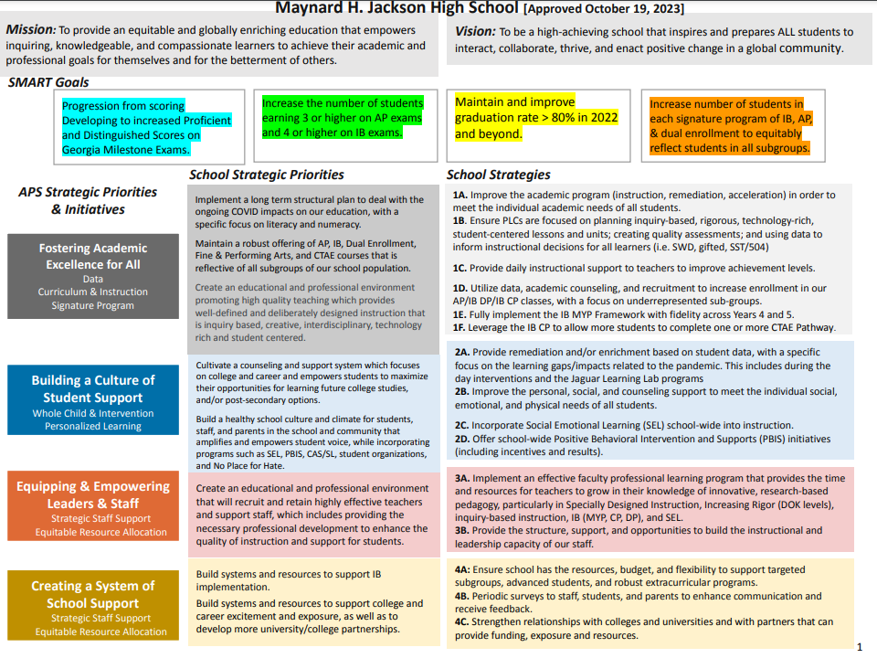
Our Strategic Plan

Slide 10
Preparing for
Budget Development

Slide 11
Discussion
Strategic Plan Priority Ranking
In preparation for the 2024-2025 Budget Development (January–March 2024), the GO Team needs to rank its Strategic Plan Priorities. Use the next slide to capture the priority ranking.

Slide 12
Strategic Plan
Priority Ranking
Insert the school’s priorities from Higher to Lower
Higher
As a Guide, below are the Priorities from last year.
Create an educational and professional environment promoting high quality teaching which provides well-defined and deliberately designed instruction that is inquiry based, creative, interdisciplinary, technology rich and student centered.
Cultivate a counseling and support system which focuses on college and career and empowers students to maximize their opportunities for learning future college studies, and/or post-secondary options.
Build a healthy school culture and climate for students, staff, and parents in the school and community that amplifies and empowers student voice, while incorporating programs such as SEL, PBIS, CAS/SL, student organizations, and No Place for Hate.
Lower

Slide 13
Action on the
Strategic Plan Priorities
The GO Team needs to TAKE ACTION (vote) on its ranked Strategic Plan Priorities. After the motion and a second, the GO Team may have additional discussion. Once discussion is concluded, the GO Team will vote.

Slide 14
Where we’re going
At our next meeting we will begin the discussion of the 2024-2025 budget.
Let me or the Chair know of any additional information you need for our future discussion.

Slide 15
Thank you

